Slide 1
CIS 290-50-4258 Capstone
Notes:
Purpose of the project
Why scouting reports benefit from AI
Overview of prompt-engineering approach

Slide 2
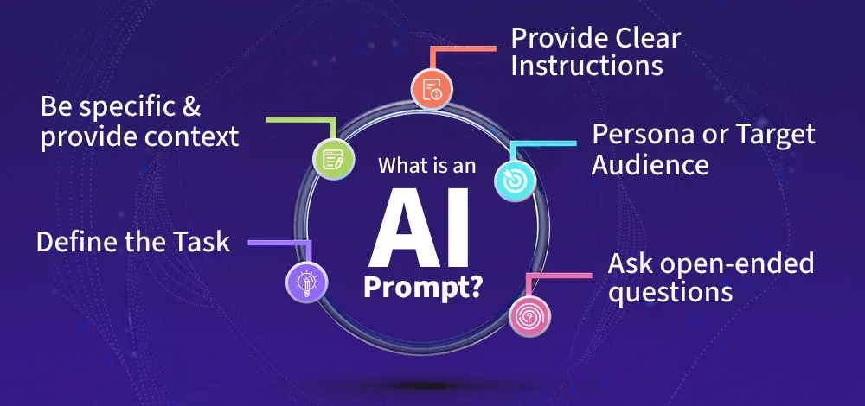
Project Overview
Improving College Football Scouting with AI Prompt Engineering
Notes:
Main goal: consistent, accurate scouting report generation
Use of structured prompts + schemas
Evaluation pipeline for testing model accuracy
Practical relevance for football analysis

Slide 3
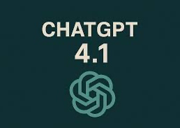
The Model
ChatGPT 4.1
Notes:
Why GPT-4.1 was selected
Strengths: reasoning, reliability, speed
Early issues: overclaiming, hallucinations
How prompt revisions improved behavior

Slide 4
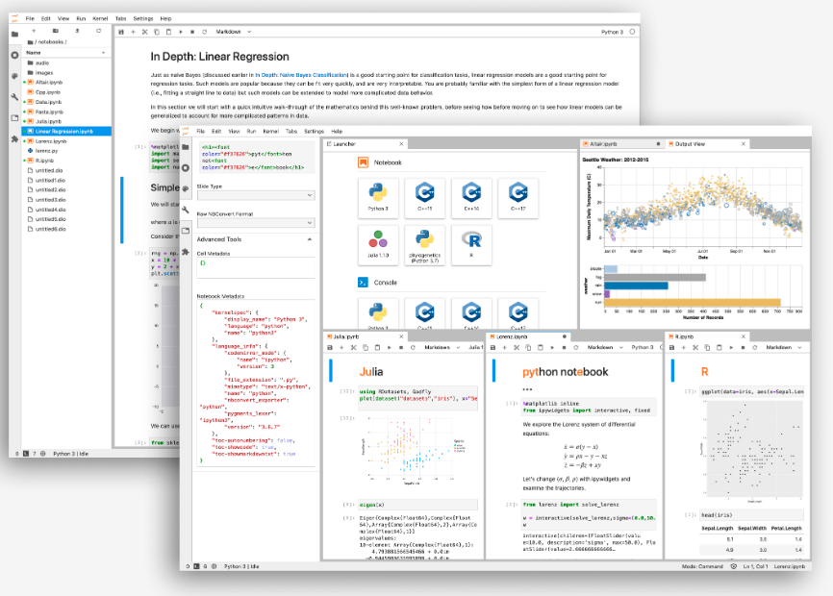
The Testing Environment
Jupyter Notebooks
Notes:
Used for automated testing and experimentation
Ran batch evaluations and logged results
Stored outputs, pass/fail results, and error notes
Enabled repeatable regression testing

Slide 5

Ethical Considerations
Model Misuse, PII, and Speculation
Notes:
Avoiding PII or analysis of individual players
Preventing speculative or unverifiable claims
Safety & refusal block to enforce boundaries
Ensuring all outputs remain grounded in real data

Slide 6
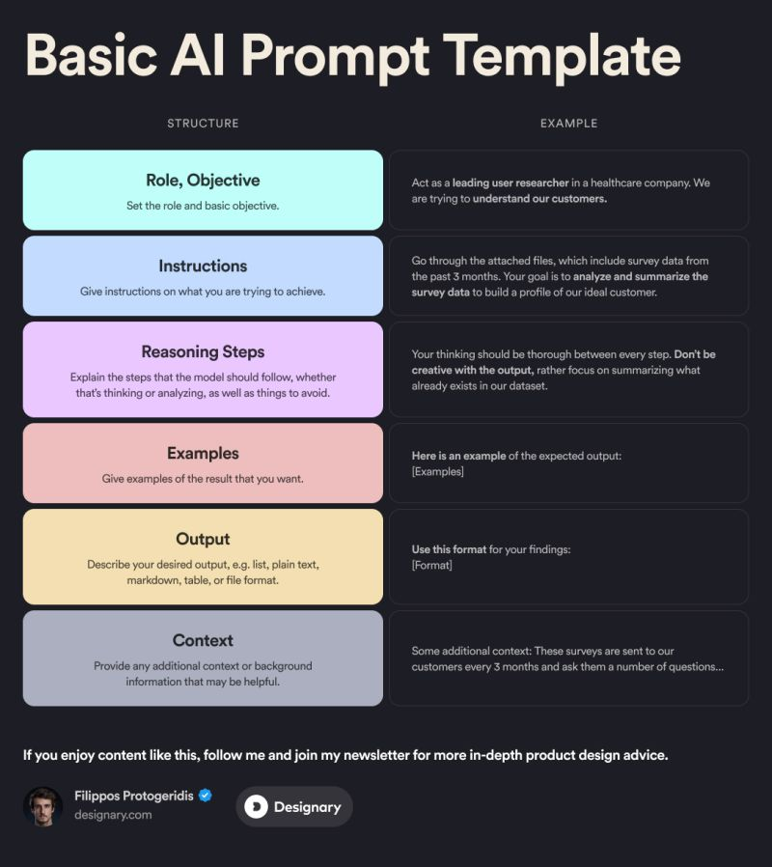
Prompt Template
Notes:
Core structure of the system
JSON schema requirement
Plan-first reasoning steps
Embedded safety rules and context blocks
Designed to constrain model behavior

Slide 7
Typical Output
Team Overview: Louisville’s 2024 offense is explosive through the air, ranking near the top of the ACC in passing explosiveness (1.65) with a strong overall passing PPA (0.40) and balanced play split (51.5% pass, 48.1% run). The run game is efficient with a 47% rushing success rate and solid line yards (3.09 per carry), helping them stay on schedule on standard downs (49.7% success). Overall offensive success rate sits at 45.8% with strong points per opportunity (4.27), indicating they finish drives well when they cross the 40. Defensively, they allow a moderate 39.2% passing success rate and 40% rushing success rate, with good havoc generation (16.3% total) but some vulnerability in field position (average start own 27.4).
Notes:
Example of a correct, data-driven report
Uses 2024 Louisville stats accurately
Follows schema and prompt directions
Shows impact of improved template

Slide 8
Edge Case Output
Louisville finished the 2002 season with a 7-6 record, displaying a potent offense that averaged 32.2 points per game and 433.7 total yards per contest. The Cardinals relied heavily on their passing attack, ranking among the top teams in Conference USA with 274.6 passing yards per game. Despite their offensive firepower, turnovers and inconsistent execution in the red zone limited their scoring efficiency. Defensively, the team struggled to contain both the run and the pass, allowing 28.5 points per game and 404.5 total yards to opponents.
Notes:
Demonstrates how the model handles non-standard or unexpected inputs
Example uses Louisville’s 2002 season to show adaptability
Confirms the model can still produce structured, coherent reports outside the usual 2024–2025 data context
Useful for testing robustness, variability, and schema compliance
Highlights the importance of evaluating performance on unusual or out-of-distribution inputs

Slide 9

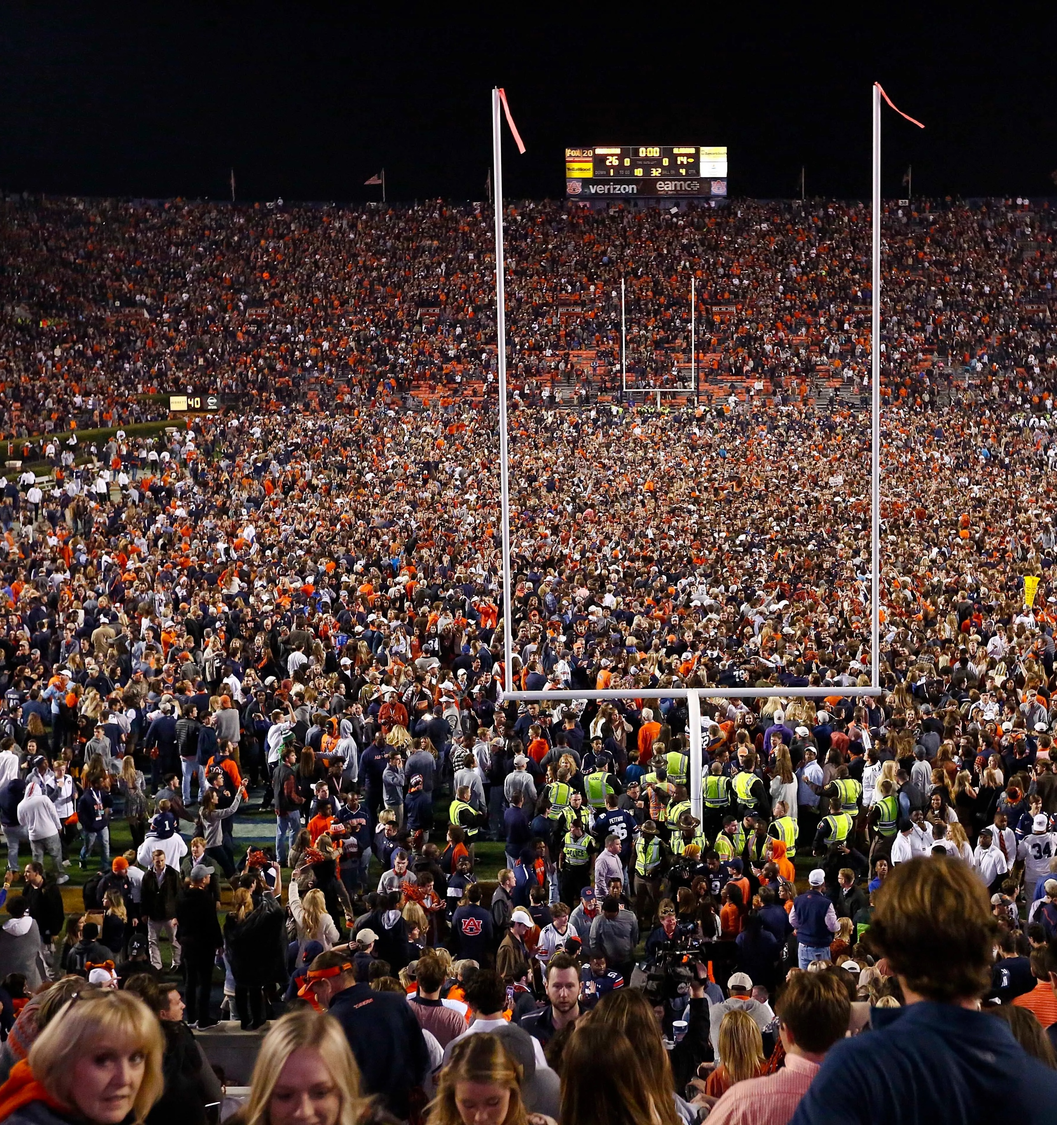

Use Cases
Coaches
Fans
Media Members
Notes:
Coaches: fast opponent scouting summaries
Fans: clearer insights into team performance
Media: structured, repeatable report formatting
Multi-audience versatility

Slide 10
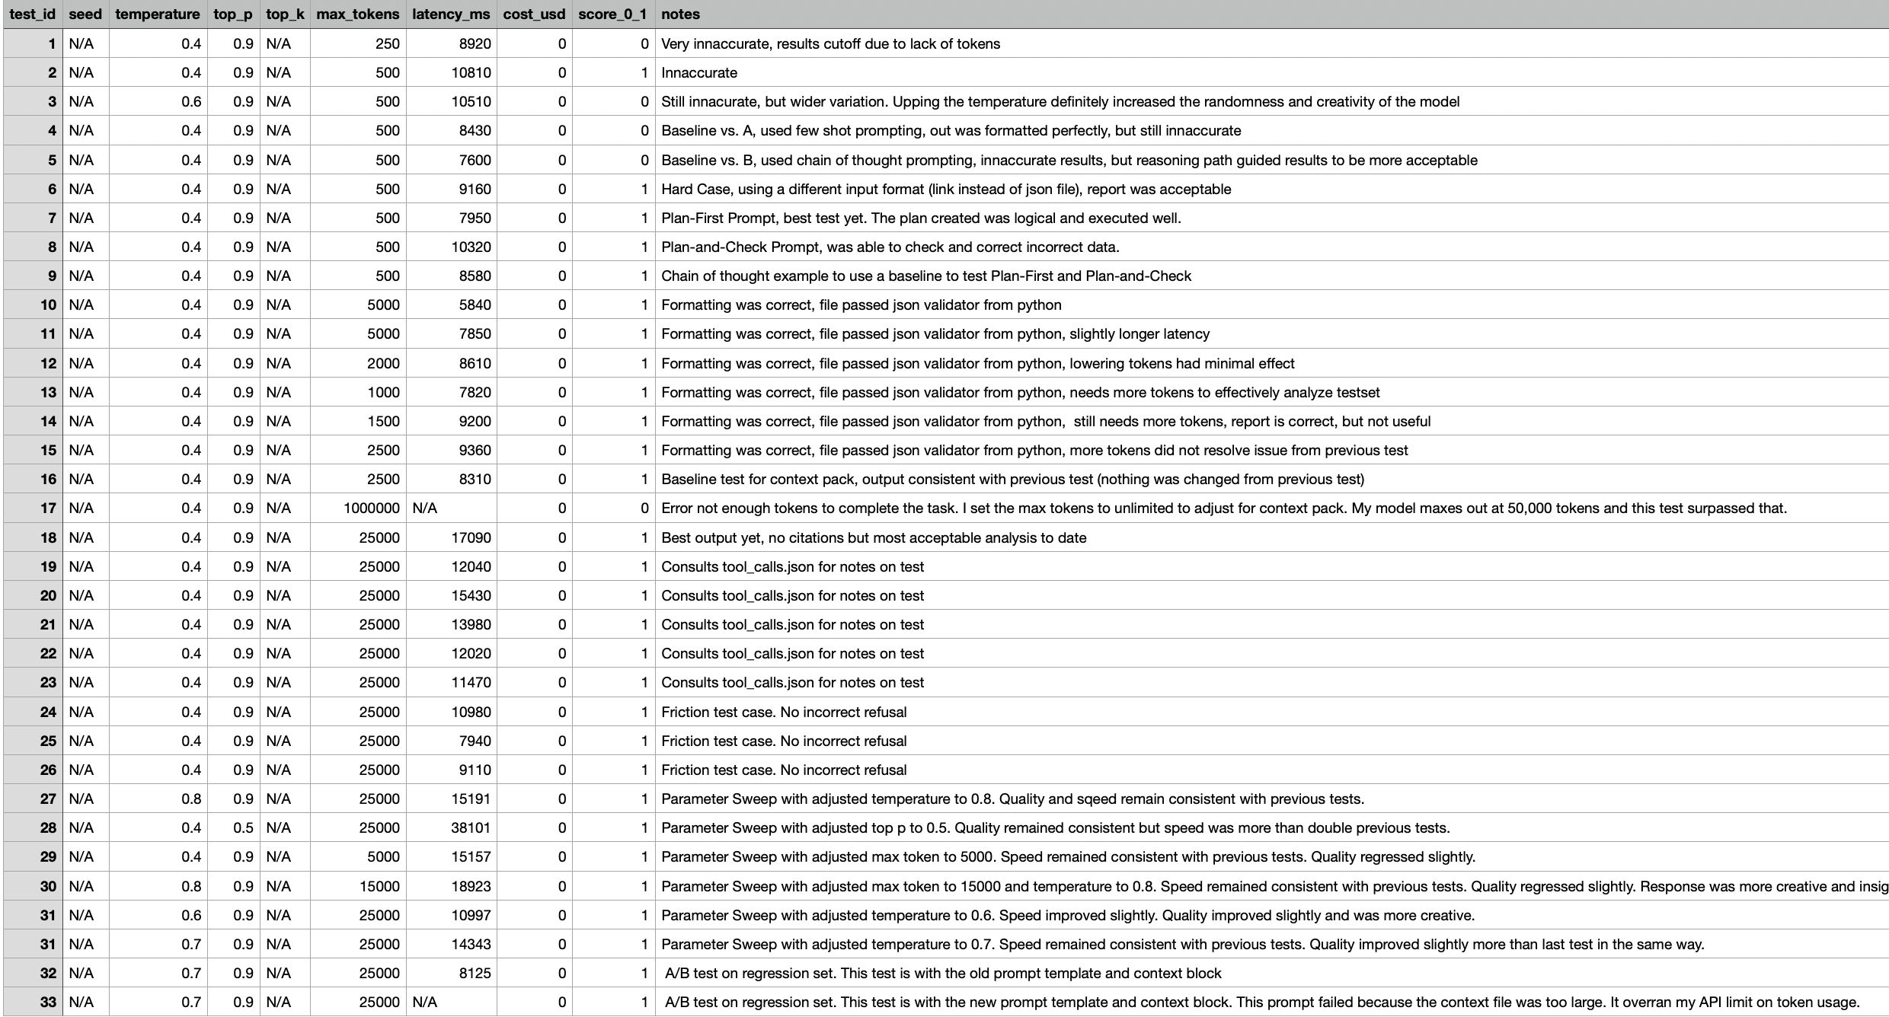
Experiments Log
Notes:
Record of all prompt changes
A/B testing of versions
Regression suite results
How improvements were measured and documented

Slide 11
Thank You for your Time and Consideration
Notes:
Final takeaway: responsible AI + rigorous evaluation
Value of prompt engineering in sports analytics
Invite questions

